Slide 1

MASTERING PREPOSITIONS IN ENGLISH
Réalisée et présentée par:
EL HAKIK Amina

Slide 2

شكون أنا؟
EL HAKIK Amina

Slide 3
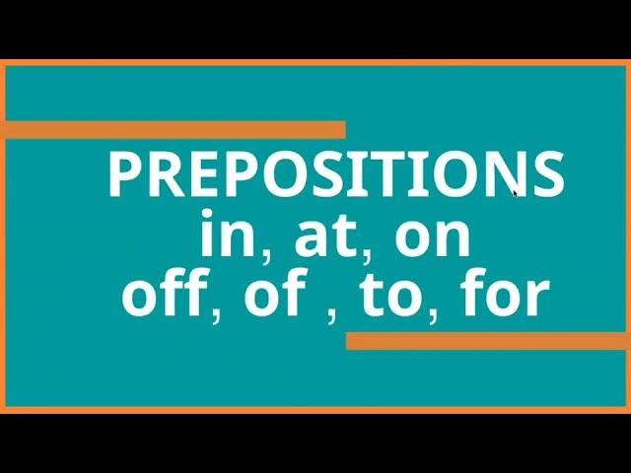
Welcome to today’s lesson on prepositions. We will focus on common prepositions such as 'in,' 'on,' 'at,' 'of,' and 'off.' By the end of this session, you will know how to use them correctly.
EL HAKIK Amina

Slide 4
What Will You Learn Today?
Learn basic greetings in English.
The correct usage of 'in,' 'on,' 'at,' 'of,' and 'off.'
Examples in sentences.
Common mistakes and how to avoid them.
""Our focus will be on learning the meaning of these prepositions, when to use them, and practicing with real-life examples."
EL HAKIK Amina

Slide 5
What are Prepositions?
Definition of Prepositions
Prepositions are words that show the relationship between nouns or pronouns and other words in a sentence.
They often describe location, time, or direction.
Example: "The book is on the table."
Note for you:
"Prepositions help to give context to our sentences, telling us where or when something is happening."
EL HAKIK Amina

Slide 6
Preposition 'In'
Location: Inside a space or area.
Example: "I am in the room."
Time: For months, years, and parts of the day.
Example: "We will meet in January."
Note for you:
"We use 'in' when talking about being inside something or for periods like months and years."
EL HAKIK Amina

Slide 7
Preposition 'On'
Location: On top of a surface.
Example: "The phone is on the table."
Time: For days and dates.
Example: "The meeting is on Monday."
Note for you:
"Use 'on' when something is physically on a surface or when talking about days and dates."
EL HAKIK Amina

Slide 8
Preposition 'At'
Location: A specific point or place.
Example: "She is at the door."
Time: For specific times.
Example: "The train arrives at 9:00 AM."
Note for you:
"We use 'at' for exact locations and times."
EL HAKIK Amina

Slide 9
Preposition 'Of'
Possession:
Example: "The cover of the book."
Part of a whole:
Example: "A piece of cake."
Note for you:
"'Of' is used to show belonging or relationships between parts and a whole."
EL HAKIK Amina

Slide 10
Preposition 'Off'
Movement away from something:
Example: "Take your shoes off."
Disconnection:
Example: "The lights are off."
Note for you:
"'Off' is used when something is being removed or disconnected."
EL HAKIK Amina

Slide 11
Practice Examples
"The keys are ___ the table."
"I was born ___ 1990."
"We will meet ___ 7 PM."
Note for you:
"Let’s practice what we’ve learned. Can you fill in the blanks with the correct prepositions?"
EL HAKIK Amina

Slide 12
Common Mistakes
Using 'in' instead of 'on' for days:
Incorrect: "I’ll see you in Monday."
Correct: "I’ll see you on Monday."
Using 'at' instead of 'in' for cities:
Incorrect: "She lives at Paris."
Correct: "She lives in Paris."
Note for you:
"Here are some common mistakes learners make. Always remember which prepositions to use for days, cities, and times."
EL HAKIK Amina

Slide 13
Let’s Practice More!
"She will arrive ___ 8 AM."
"The book is ___ the shelf."
"We live ___ New York."
"The power is ___."
Note for you:
"Now let’s try a few more examples to reinforce your understanding."
EL HAKIK Amina

Slide 14
Final Recap
'In' for months and locations.
'On' for days and surfaces.
'At' for specific times and places.
'Of' for possession.
'Off' for disconnection or movement away.
Note for you:
"We’ve covered the most important prepositions and how to use them. Keep practicing to improve!"
EL HAKIK Amina

Slide 15
More examples
I live in Paris.
Explanation: "In" is used to indicate being inside a city, country, or large area.
EL HAKIK Amina

Slide 16
More examples
She is in the car.
Explanation: "In" is used when referring to being inside an enclosed vehicle.
EL HAKIK Amina

Slide 17
More examples
He will arrive in the morning.
Explanation: "In" is used to refer to parts of the day (morning, afternoon, evening).
EL HAKIK Amina

Slide 18
More examples
The keys are in my bag.
Explanation: "In" is used to indicate something inside a container or enclosed space.
EL HAKIK Amina

Slide 19
More examples
They met in 2020.
Explanation: "In" is used for years, months, or long periods of time.
EL HAKIK Amina

Slide 20
More examples
The book is on the table.
Explanation: "On" is used when something is physically resting on a surface.
EL HAKIK Amina

Slide 21
More examples
She was born on June 15th.
Explanation: "On" is used to refer to specific days and dates.
EL HAKIK Amina

Slide 22
More examples
He put the picture on the wall.
Explanation: "On" is used for something attached or supported by a surface
EL HAKIK Amina

Slide 23
More examples
We talked on the phone.
Explanation: "On" is used to describe communication via a device (phone, internet, etc.).
EL HAKIK Amina

Slide 24
More examples
The meeting is on Monday.
Explanation: "On" is used for days of the week.
EL HAKIK Amina

Slide 25
More examples
She is waiting at the bus stop.
Explanation: "At" is used for specific locations or points.
EL HAKIK Amina

Slide 26
More examples
We will meet at 7 PM.
Explanation: "At" is used to indicate a specific time.
EL HAKIK Amina

Slide 27
More examples
He is at the library.
Explanation: "At" is used for specific places where activities take place (library, school).
EL HAKIK Amina

Slide 28
More examples
I am good at math.
Explanation: "At" is used to express skill or ability in a particular subject or activity.
EL HAKIK Amina

Slide 29
More examples
We had dinner at the restaurant.
Explanation: "At" is used for a specific location where an action occurs.
EL HAKIK Amina

Slide 30
More examples
The cover of the book is red.
Explanation: "Of" is used to show possession or belonging.
EL HAKIK Amina

Slide 31
More examples
He is a friend of mine.
Explanation: "Of" is used to indicate a relationship between two people or things.
EL HAKIK Amina

Slide 32
More examples
The smell of roses filled the air.
Explanation: "Of" is used to describe what something is made of or contains.
EL HAKIK Amina

Slide 33
More examples
The capital of France is Paris.
Explanation: "Of" is used to indicate the relationship between a part and the whole.
EL HAKIK Amina

Slide 34
More examples
She is the president of the company.
Explanation: "Of" is used to indicate the role or position in relation to an organization or group.
EL HAKIK Amina

Slide 35
More examples
He took his shoes off.
Explanation: "Off" is used to describe the removal of something from a surface.
EL HAKIK Amina

Slide 36
More examples
The power is off.
Explanation: "Off" is used when something is disconnected or deactivated (electricity, machines).
EL HAKIK Amina

Slide 37
More examples
He fell off the bike.
Explanation: "Off" is used when something moves away from or falls from a surface.
EL HAKIK Amina

Slide 38
More examples
The airplane took off on time.
Explanation: "Off" is used to describe something leaving the ground (flight).
EL HAKIK Amina

Slide 39
More examples
The paint is coming off the wall.
Explanation: "Off" is used when something is detaching or being removed from a surface.
EL HAKIK Amina

Slide 40
More examples
We are meeting in the park at 3 PM.
Explanation: "In" is for the general location (park), and "at" is for the specific time.
EL HAKIK Amina

Slide 41
More examples
We are meeting in the park at 3 PM.
Explanation: "In" is for the general location (park), and "at" is for the specific time.
EL HAKIK Amina

Slide 42
More examples
He is sitting on the chair.
Explanation: "On" is used because the person is physically on top of a surface (the chair).
EL HAKIK Amina

Slide 43
More examples
The concert is on Friday night.
Explanation: "On" is used for specific days, and "night" refers to the time of the day.
EL HAKIK Amina

Slide 44
More examples
She arrived at the airport in the afternoon.
Explanation: "At" is used for the specific location (airport), and "in" is for the time period (afternoon).
EL HAKIK Amina

Slide 45
More examples
I was born in 1995 on a Monday.
Explanation: "In" is used for the year, and "on" is used for the specific day.
EL HAKIK Amina

Slide 46
Thank You for Joining!
See you next time!
Thank you for participating! If you have any questions, feel free to ask
EL HAKIK Amina

